Slide 1
Applied Natural Language Processing CIS 4120 (Spring 2023)
Pandas, Matplotlib, Accessing Different Text Corpus (Week 2)
Instructor: Jooho Kim

Slide 2
Topics
Today’s class
Pandas, Matplotlib
Accessing Different Text Corpus (from the textbook)
Python tutorial
More details about data sources if we have time
Week 2
Notes:
POWERPOINT LAYOUT: CONTENT WITH CAPTION
Headline/Caption – Plus Text to Right

Slide 3
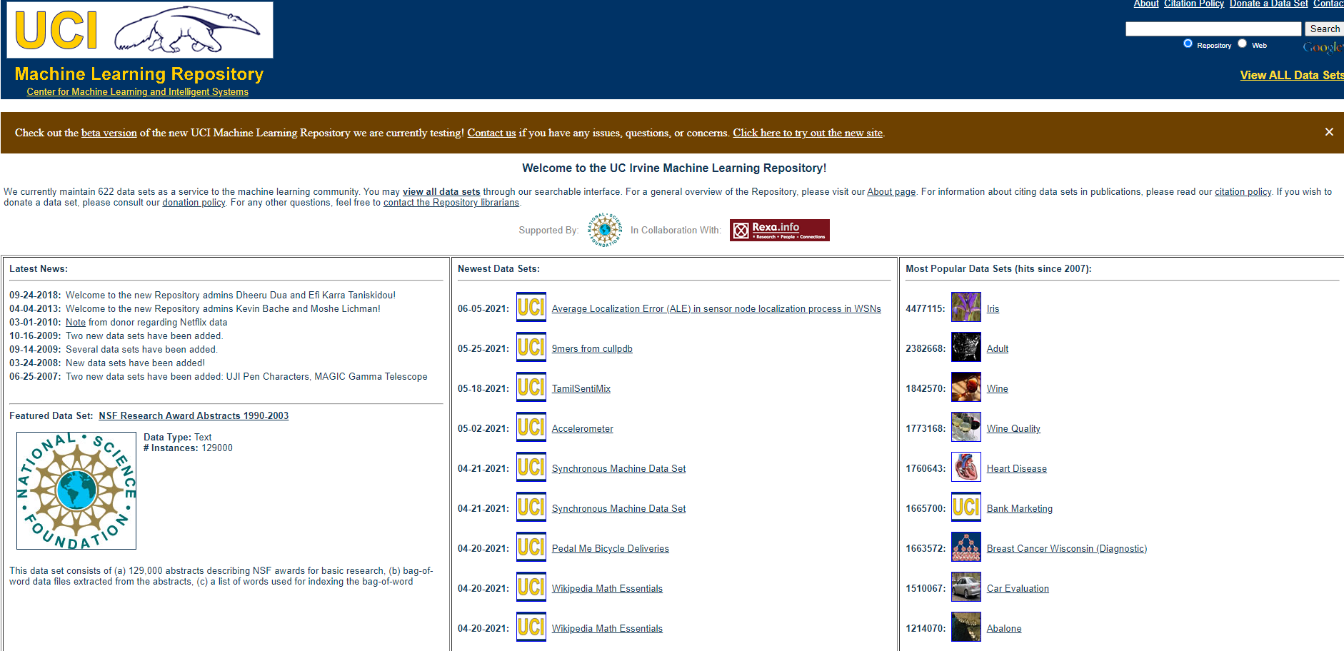
Data Source: UCI Data Repository
https://archive.ics.uci.edu/ml/index.php
Notes:
POWERPOINT LAYOUT: TITLE AND CONTENT

Slide 4
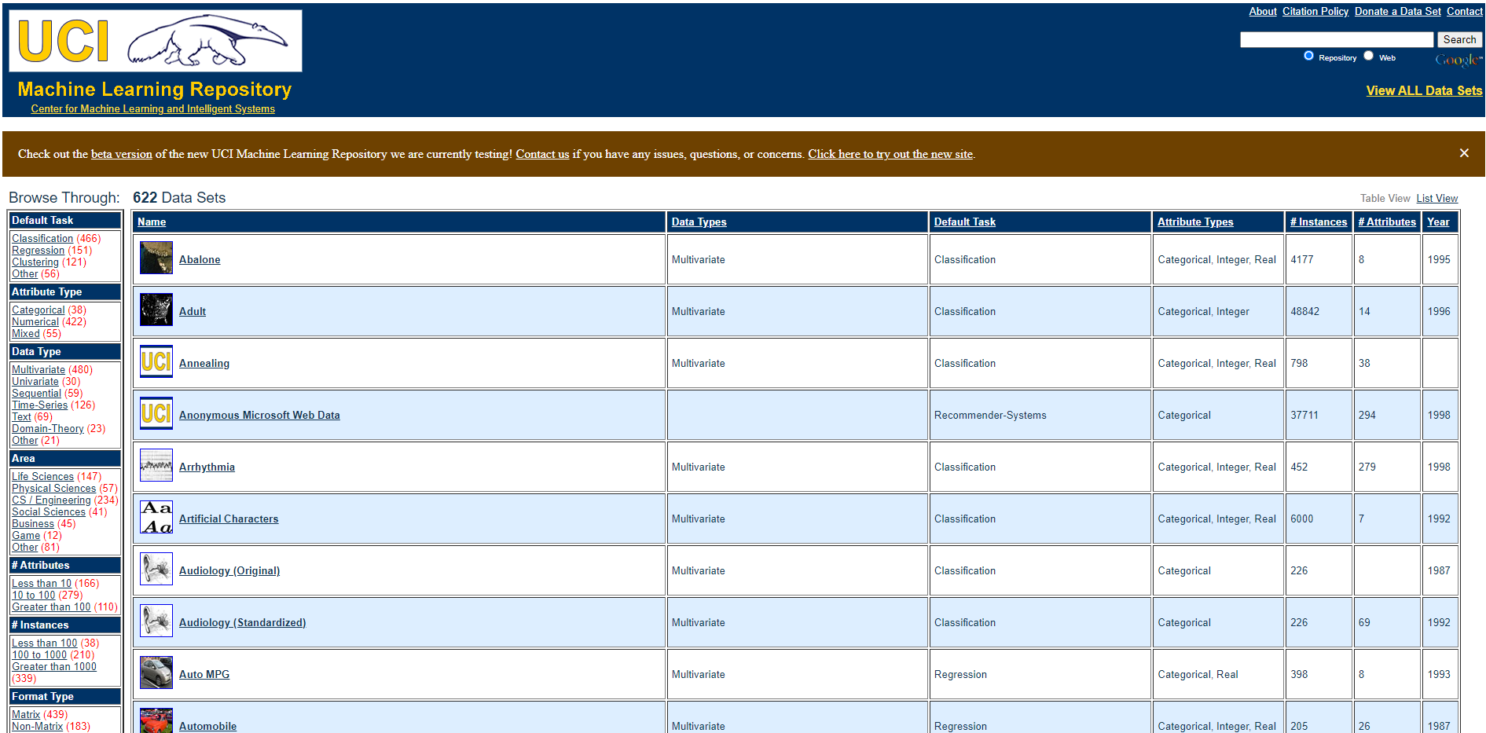
Data Source: UCI Data Repository
https://archive.ics.uci.edu/ml/datasets.php
Notes:
POWERPOINT LAYOUT: TITLE AND CONTENT

Slide 5
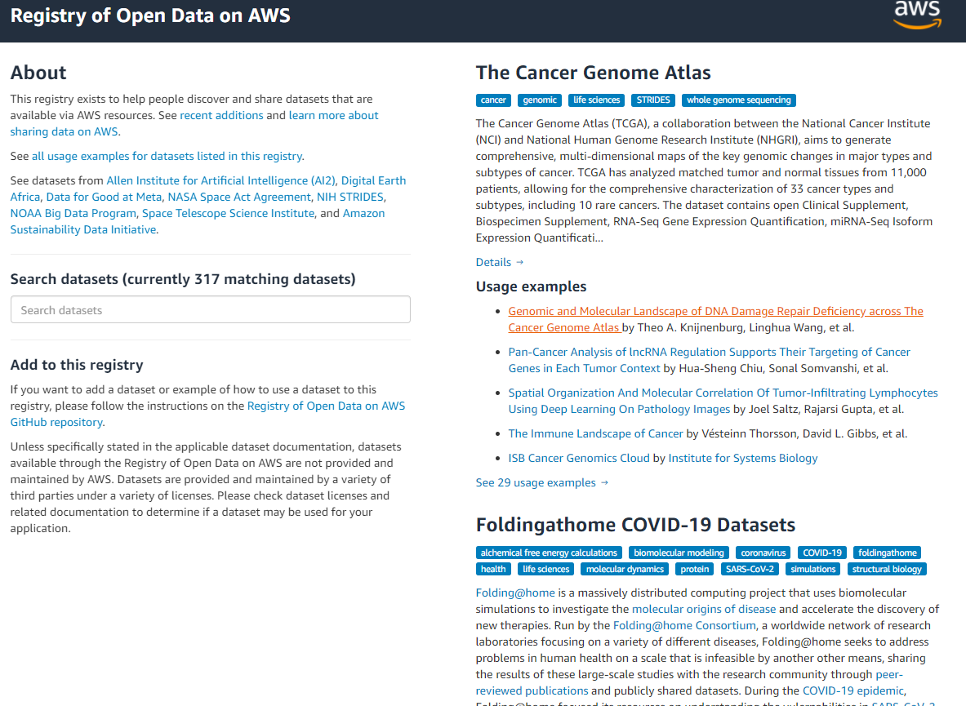
Data Source: Open Data on AWS
Notes:
POWERPOINT LAYOUT: TITLE AND CONTENT

Slide 6
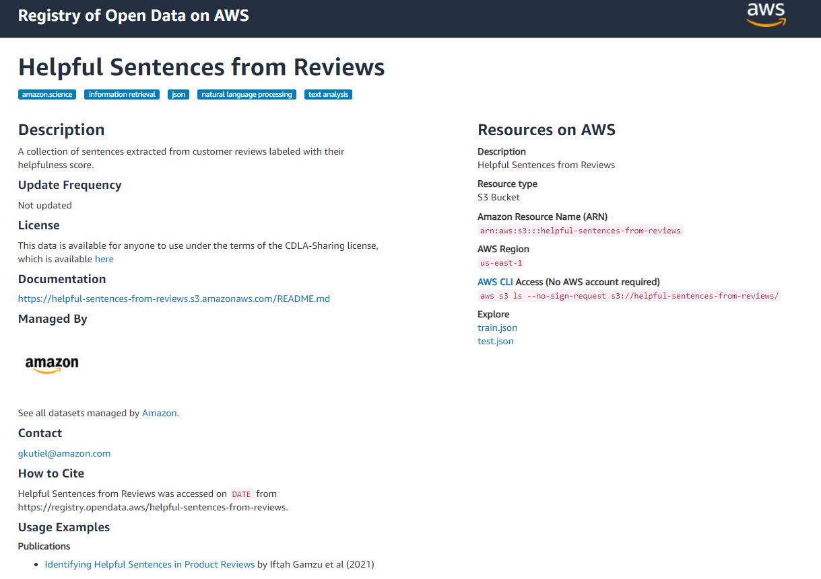
Data Source: Open Data on AWS
The link for the main page
https://registry.opendata.aws/
The link for this data set
https://registry.opendata.aws/helpful-sentences-from-reviews/
The link for the publication
https://arxiv.org/abs/2104.09792
Search for more data sets
Notes:
POWERPOINT LAYOUT: TITLE AND CONTENT

Slide 7
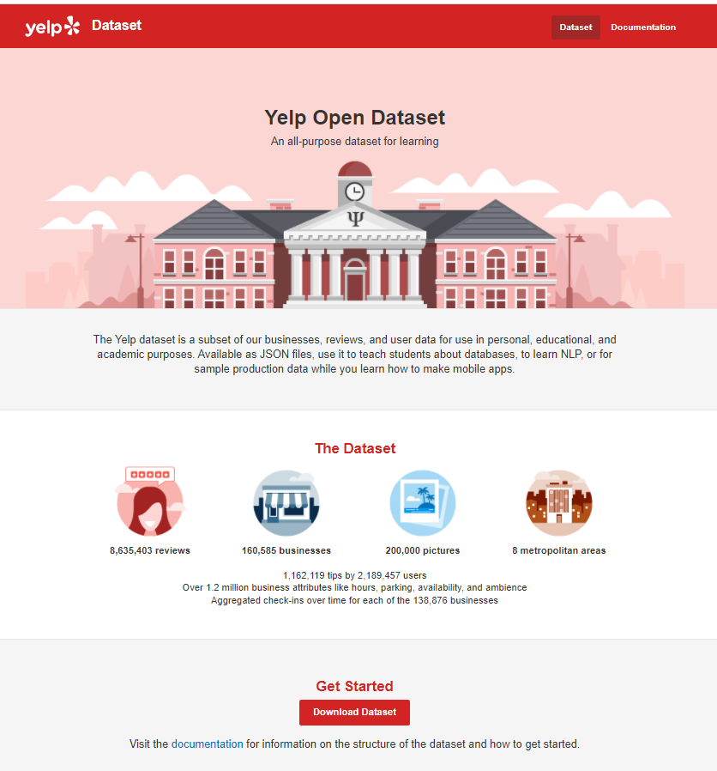
Data Source: Yelp Academic Data Sets
https://www.yelp.com/dataset
Notes:
POWERPOINT LAYOUT: TITLE AND CONTENT

Slide 8
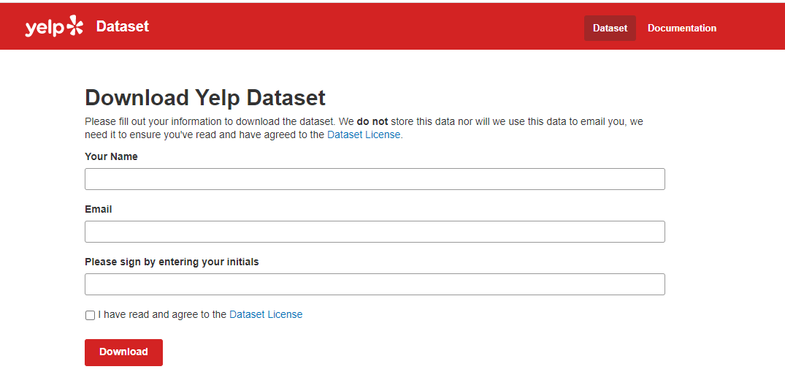
Data Source: Yelp Academic Data Sets
Notes:
POWERPOINT LAYOUT: TITLE AND CONTENT

Slide 9
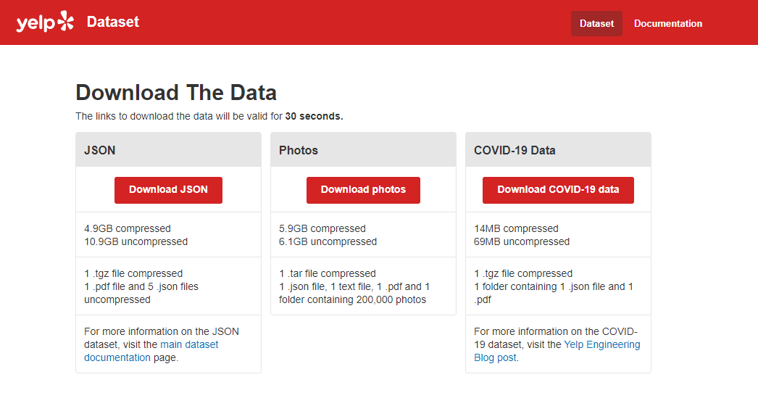
Data Source: Yelp Academic Data Sets
Notes:
POWERPOINT LAYOUT: TITLE AND CONTENT

Slide 10
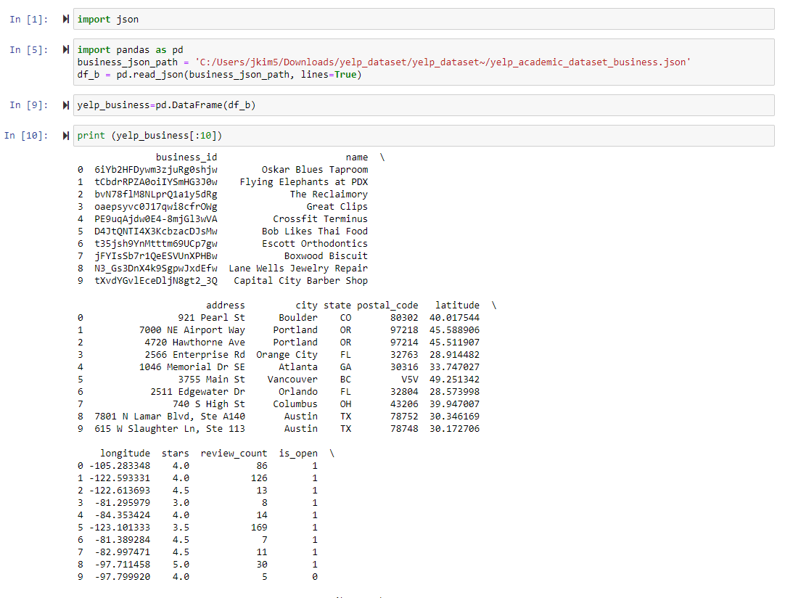
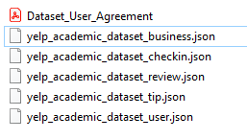
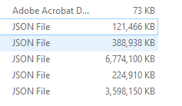
Notes:
POWERPOINT LAYOUT: TITLE AND CONTENT

Slide 11
Data Source: Yelp Academic Data Sets
Yelp Business
Business_id, name, address, city, state, zip code, lat, lng, starts, review_count, is_open, attributes, categories, hours
Yelp Reviews
review ID, user ID, rating, comments, …
Yelp Tip
User_id, business_id, text, date, compliment_count
Yelp User
Yelp Check-in
Relationships between these data sets.
How to combine in a way to leverage them.
Unit of Analysis: at a business level? at a review level?
In case you want to include user data (characteristics) in your analysis…
Notes:
POWERPOINT LAYOUT: TITLE AND CONTENT

Slide 12
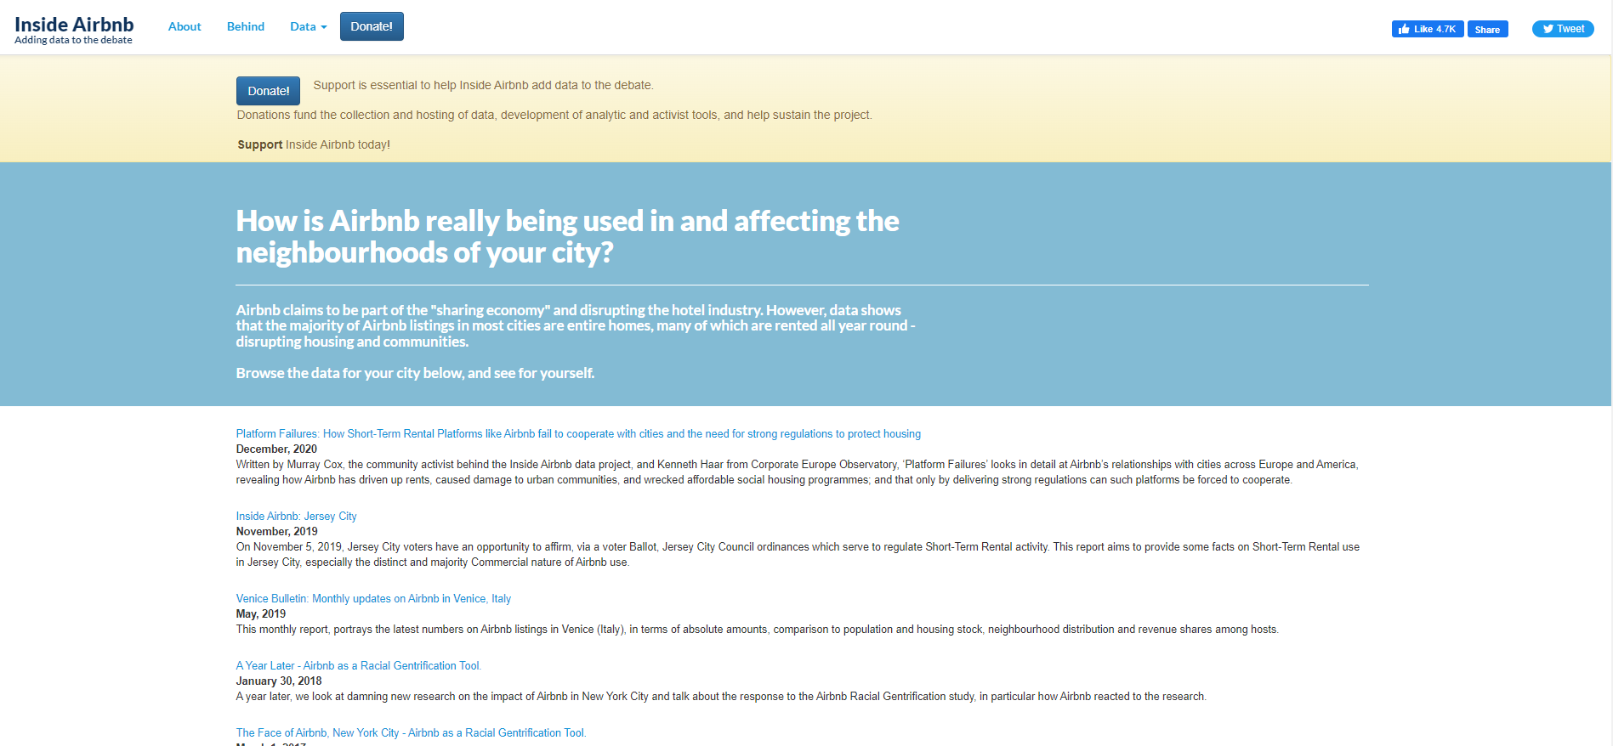
Data Source: Inside Airbnb
Notes:
POWERPOINT LAYOUT: TITLE AND CONTENT

Slide 13
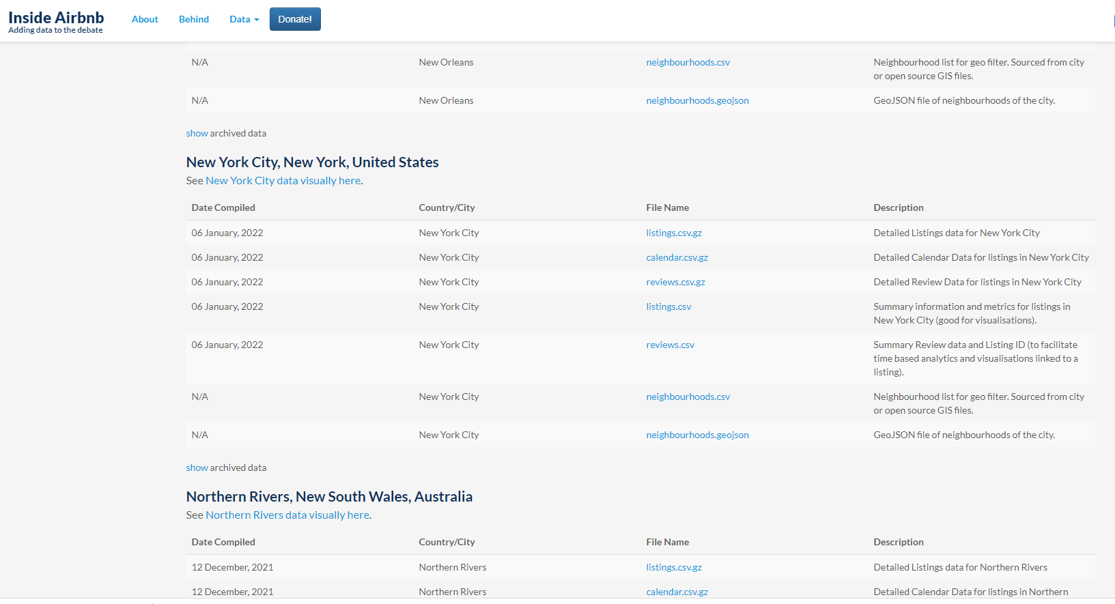
Notes:
POWERPOINT LAYOUT: TITLE AND CONTENT

Slide 14
Data Source: Inside Airbnb
Reviews
Listing_id, (review) id, date, reviewer_id, reviewer_name, comments
Calendar
Listing_id, date, available, price, adjusted_price, min_nights, max_nights
Listings
Listing_id, descriptions, …, some host characteristics, …
Unit of Analysis: at a listing level? at a review level?
In case you want to include host data (characteristics) in your analysis…
Notes:
POWERPOINT LAYOUT: TITLE AND CONTENT

